Slide 1

Tseliso Ramoeletsi
Quantum Analytics – Python Assignment 2023

Slide 2
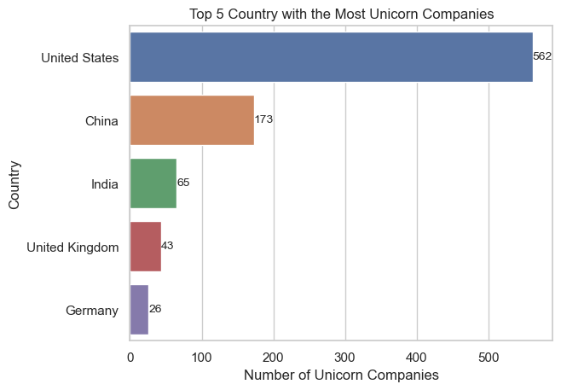
Top 5 Countries with the Most Unicorn Companies
OBSERVATION
The United States has produced the most unicorn companies.

Slide 3
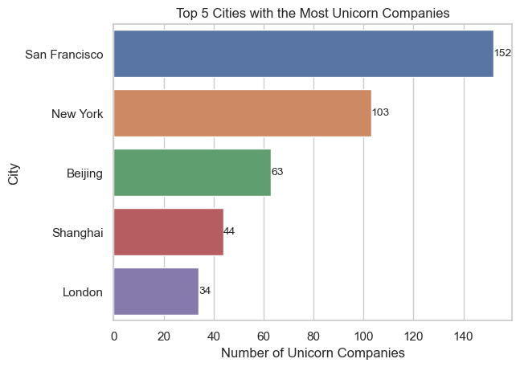
Top 5 Cities with the Most Unicorn Companies
OBSERVATION
San Francisco boasts the most Unicorn Companies having produced 152 companies.
San Francisco and New York are both from the United States in line with our first illustrations

Slide 4
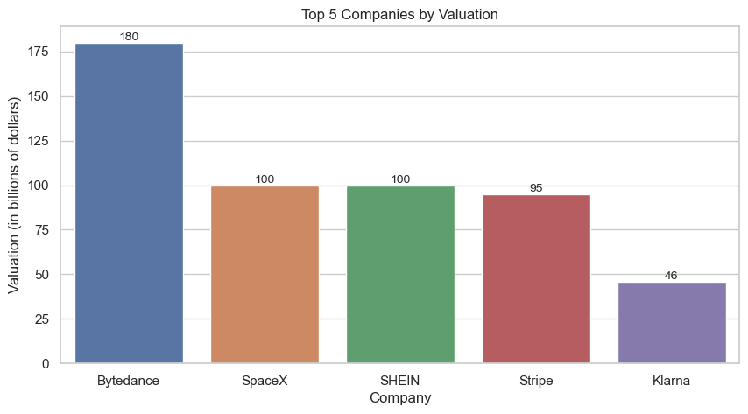
Top 5 Companies by their Valuation.
OBSERVATION
Bytedance from China has a valuation of a $180 Billion.
Space X which is from the United States which has the highest number of Unicorn companies fell short of China’s Bytedance which is the second largest producer of Unicorn Companies.

Slide 5
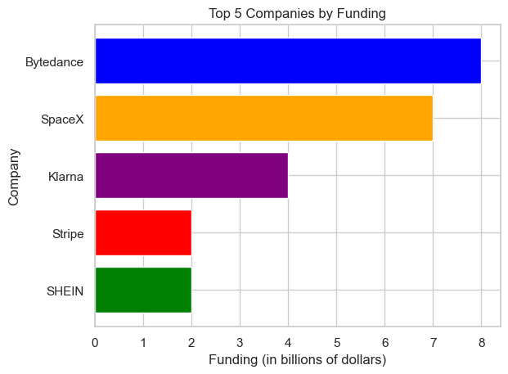
Top 5 Companies by received Funding.
OBSERVATION
Bytedance from China has the largest investment/funding of $8 Billion, consistent with their turnover as illustrated by our previous slide.
Space X which is from the United States is the second most funded unicorn company at 7 Billion.

Slide 6
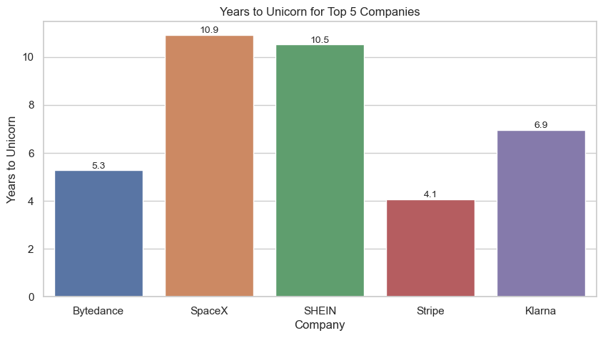
Top 5 Companies by their Years to Unicorn
OBSERVATION
Stripe from the United States have taken the least amount of years to become a Unicorn company since they were founded with Bytedance from China being second taking just over 5.3 years.
Space X which is from the United States took the most amount of years with Shein from China being the second most at 10.5 years.

Slide 7
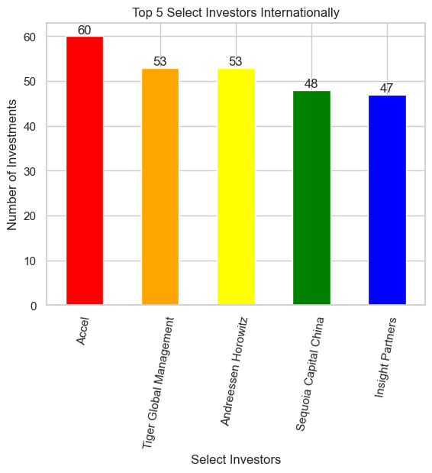
Top 5 Companies by their Years to Unicorn
OBSERVATION
Accel is the leading investor internationally with 60 investments nested in unicorn companies Globally

